Slide 1
Interacting Particle Systems and Efficient Approximations for Large Sparse Graphs
Senior Thesis Supervisor: Kavita Ramanan
Graduate Student Mentor: Ankan Ganguly
Presenter: Mitchell Wortsman

Slide 2
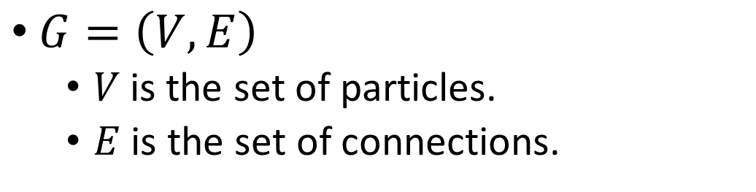
Step 1: Graphs
$G=\left(V,E\right)$
$V$is the set of particles.
$E$ is the set of connections.

Slide 3
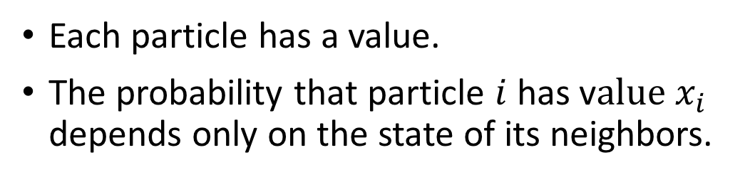
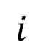
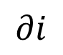
Step 2: Graphical Models
$$∂i$$
$$i$$
Each particle has a value.
The probability that particle $i$ has v$alue x_{i}$ depends only on the state of its neighbors.

Slide 4
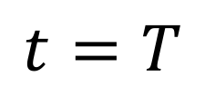
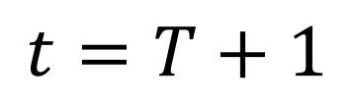
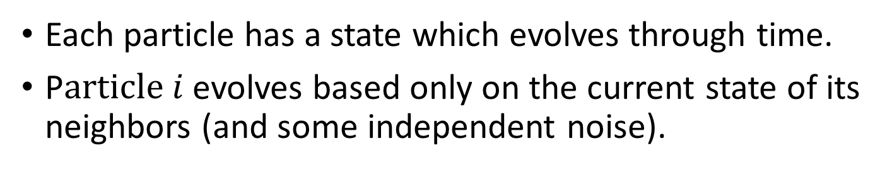
Step 3: Interacting Particle Systems
$$t=T$$
$$t=T+1$$
Each particle has a state which evolves through time.
P$article i$evolves based only on the current state of its neighbors (and some independent noise).

Slide 5
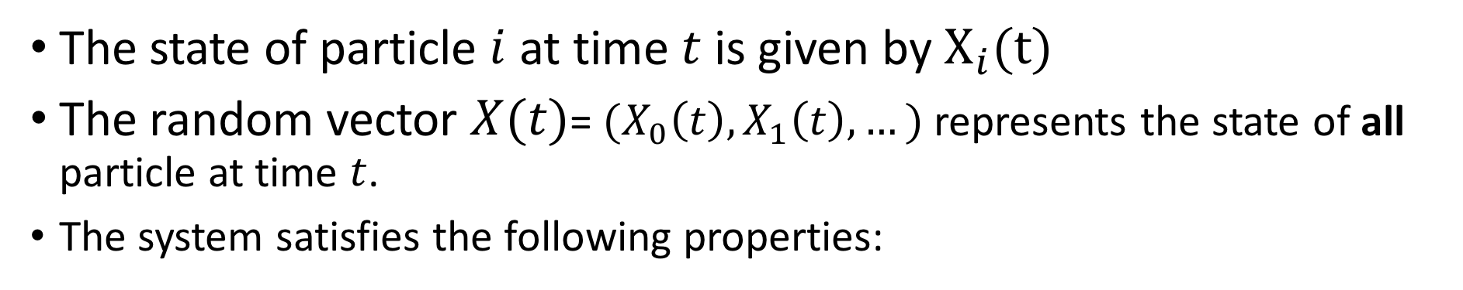

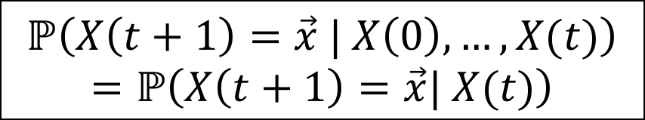
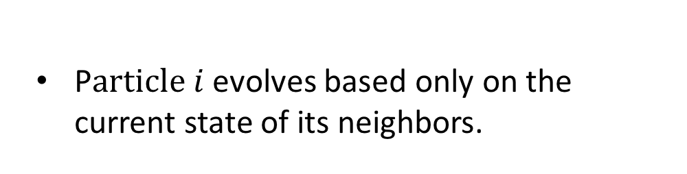
Step 4: Formally…
The state of particle $i$ at time $t$ is given by $X_{i}(t)$
The random vector $X(t)$= $(X_{0}\left(t\right), X_{1}\left(t\right),…)$ represents the state of all particle at time $t$.
The system satisfies the following properties:
1. The Markov Property
2. The Local Interactions Property
$$ℙ\left(X\left(t+1\right)=\vec{x} | X\left(0\right),…,X(t)\right)$$
$$=ℙ\left(X\left(t+1\right)=\vec{x}| X(t)\right)$$
$$ℙ\left(X_{i}\left(t+1\right)=v | X(t)\right)$$
$$=f\left(v, { X}_{i}\left(t\right), { X}_{∂i}\left(t\right)\right)$$
If we know the present, knowing the past does not give us any more information about the future.
P$article i$evolves based only on the current state of its neighbors.

Slide 6
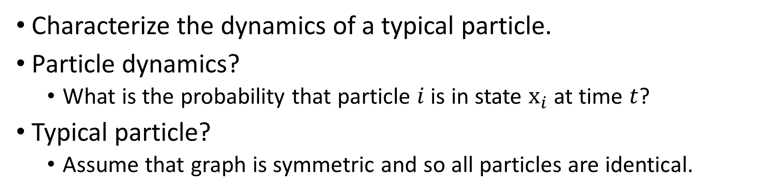
Step 5: The Goal
Characterize the dynamics of a typical particle.
Particle dynamics?
What is the probability that particle $i$ is in state $x_{i}$ at time $t$?
Typical particle?
Assume that graph is symmetric and so all particles are identical.

Slide 7
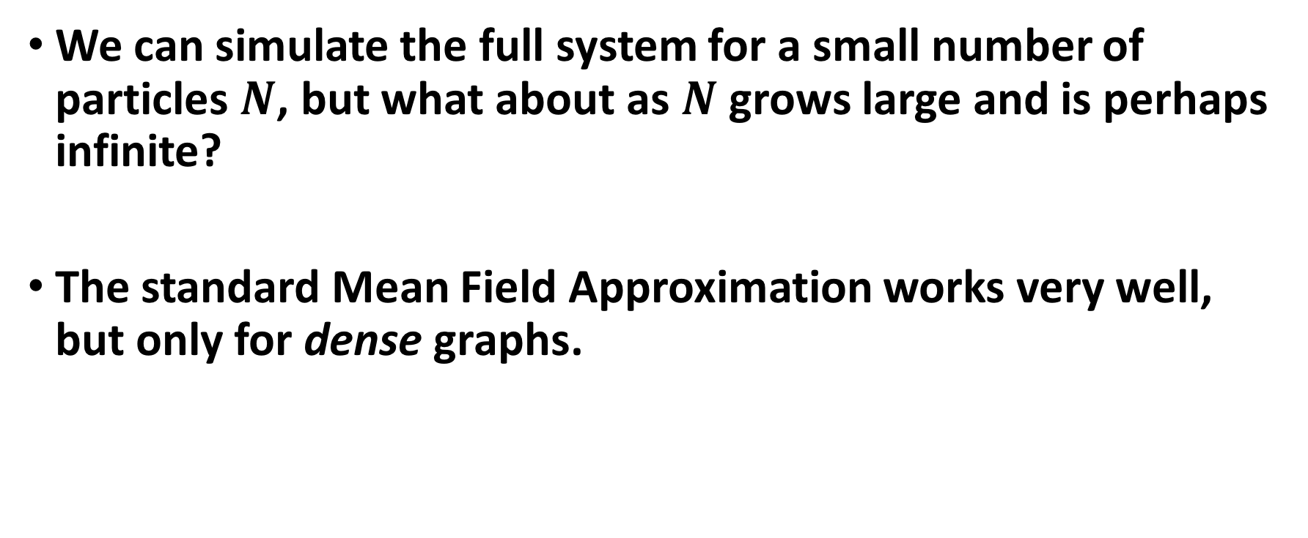
Step 6: Why is this a challenge?
We can simulate the full system for a small number of particles $N$, but what about as $N$ grows large and is perhaps infinite?
The standard Mean Field Approximation works very well, but only for dense graphs.
Notes:
“Stochastic dynamics arising in a variety of applications including epidemiology, statistical physics, and load balancing are modeled by so called interacting particle systems”

Slide 8
Step 7: Why are we interested?
Epidemiology
Statistical Physics
Load Balancing
Information Theory
Genetics
Machine Learning
Notes:
“Stochastic dynamics arising in a variety of applications including epidemiology, statistical physics, and load balancing are modeled by so called interacting particle systems”

Slide 9
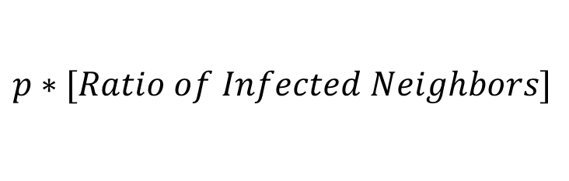
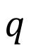
Susceptible-Infected-Recovered (SIR) Process
$$p∗[Ratio of Infected Neighbors]$$
$$q$$
Susceptible
Infected
Recovered
Notes:
Mention also viruses in other systems, distributed systems
Define IPS

Slide 10
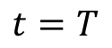
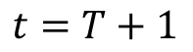
SIR Process on a Ring
$$t=T$$
$$t=T+1$$

Slide 11
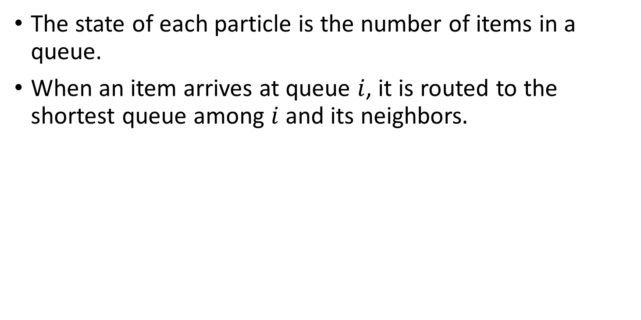
Load Balancing
The state of each particle is the number of items in a queue.
When an item arrives at queue $i$, it is routed to the shortest queue among $i$ and its neighbors$.$
Item
7
5
4
An item incident at the queue with 5 items
will be routed to the queue with 4 items.

Slide 12
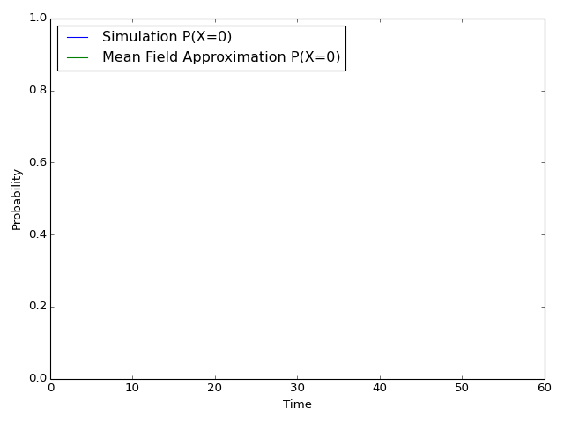
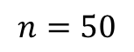
The SIR Process on a Complete Graph
Interaction Network
$$n=50$$

Slide 13
The Mean Field Approximation

Slide 14
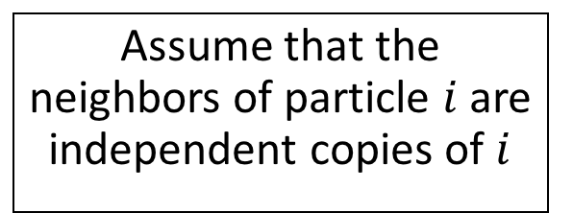
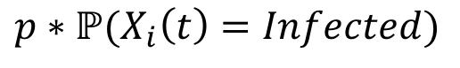
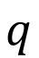

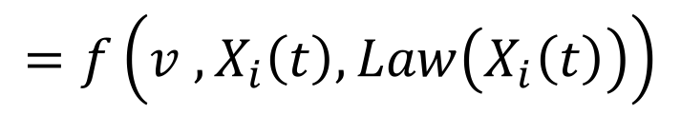

Mean Field Approximation
$$p∗ℙ(X_{i}\left(t\right)=Infected)$$
$$q$$
Susceptible
Infected
Recovered
$$ℙ\left(X_{i}\left(t+1\right)=v{ | X}_{i}\left(t\right) \right)$$
Assume that the neighbors of particle $i$ are independent copies of $i$
$$=f\left(v{ , X}_{i}\left(t\right), Law\left(X_{i}\left(t\right)\right)\right)$$
This approximation is exact for the complete graph as the population size tends to infinity (Oelschläger, 1984).
Recently been shown to be asymptotically accurate for sequences of dense graphs whose degree goes to infinity (Bhamidi, Budhiraja, Wu, 2017).
In many applications the mean-field approximation is used for any graph.
$$ℙ\left(X_{i}\left(t+1\right)=v | X(t)\right)$$
$$=f\left(X_{i}\left(t\right), Law\left(t\right)\right)$$
Notes:
A martingale approach to the law of large numbers for weakly interacting stochastic processes. Ann. Probab. 12(2), 458–479 (1984)

Slide 15
The SIR Process on a Ring
Interaction Network
$$n=50$$

Slide 16
Step 8: Our Local Recursions
We build on recent theoretical results by Lacker, Ramanan, and Wu (2018) to construct a novel ‘Local Recursion’.
Notes:
“Stochastic dynamics arising in a variety of applications including epidemiology, statistical physics, and load balancing are modeled by so called interacting particle systems”

Slide 17
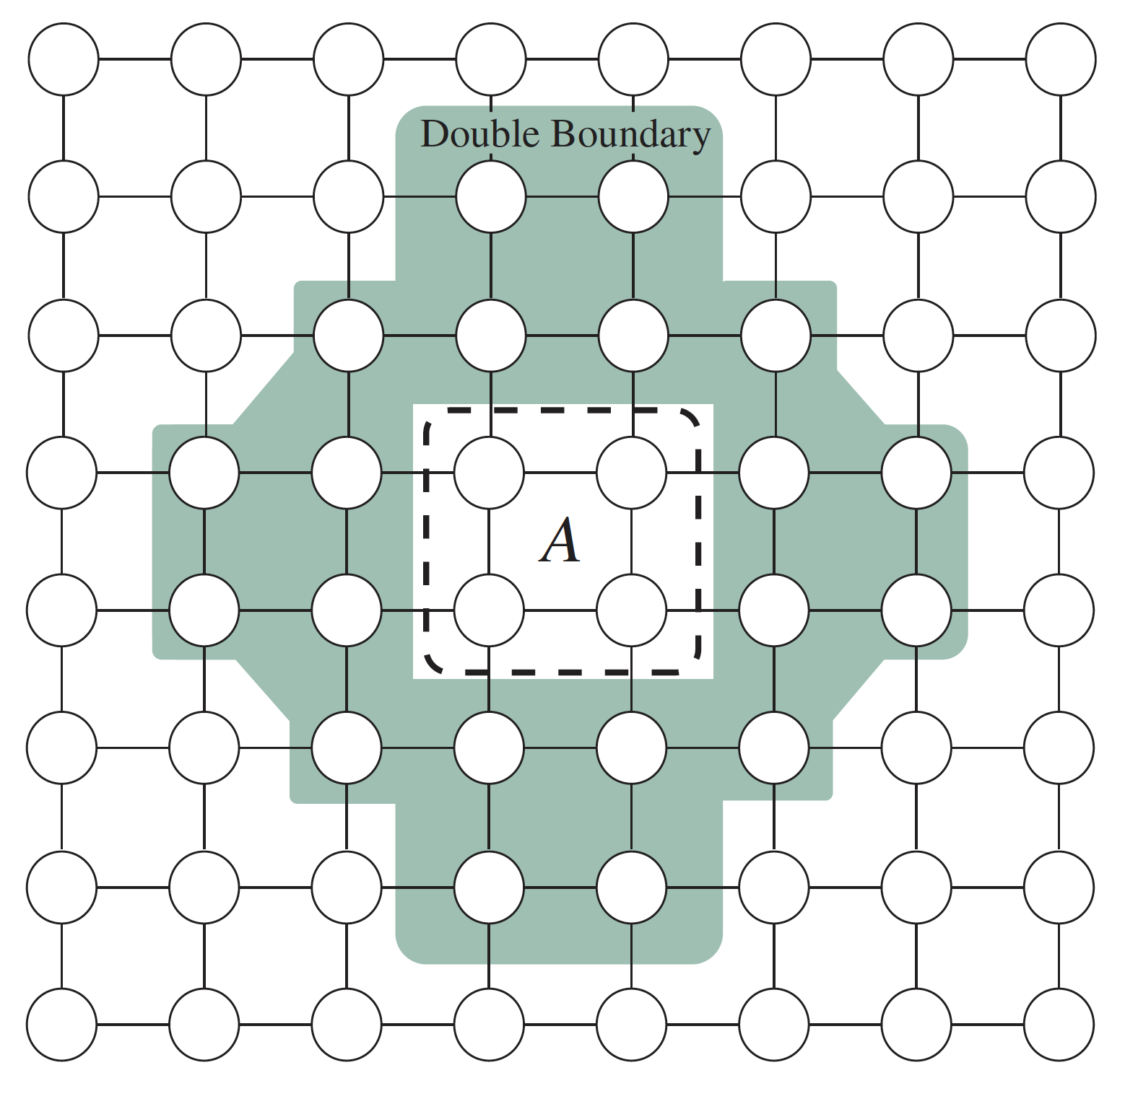
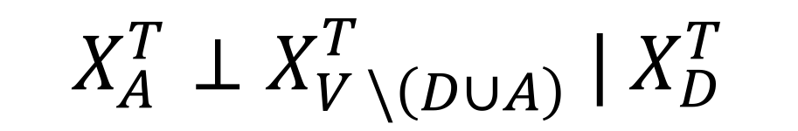
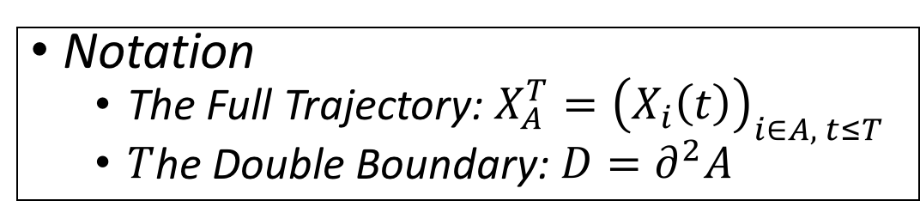
Dynamic Conditional Independence (Lacker, Ramanan, Wu 2018)
Notation
The Full Trajectory: $X_{A}^{T}={\left(X_{i}\left(t\right)\right)}_{i∈A, t≤T}$
$T$he Double Boundary: $D=∂^{2}A$
$$X_{A}^{T}⊥X_{V \backslash \left(D∪A\right)}^{T} | X_{D}^{T}$$

Slide 18
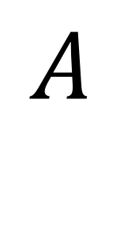
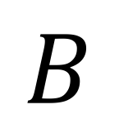
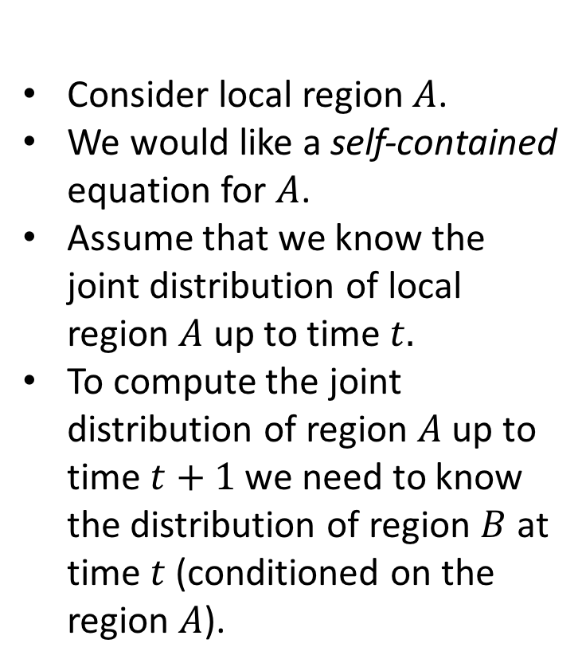
Our Local Recursion
Consider local region$A$.
We would like a self-contained equation for $A$.
Assume that we know the joint distribution of local region $A$ up to time $t.$
To compute the joint distribution of region $A$ up to time $t+1$ we need to know the distribution of region $B$ at time $t$ (conditioned on the region $A$).
0
$$A$$
-1
1
$$B$$
-2
2

Slide 19
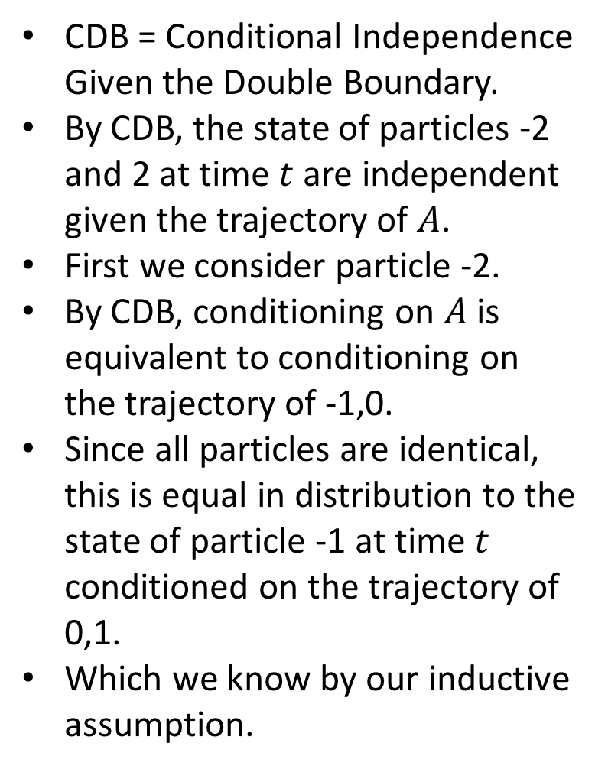
Our Local Recursion (2)
CDB = Conditional Independence Given the Double Boundary.
By CDB, the state of particles -2 and 2 at time $t$are independent given the trajectory of $A$.
First we consider particle -2.
By CDB, conditioning on $A$ is equivalent to conditioning on the trajectory of -1,0.
Since all particles are identical, this is equal in distribution to the state of particle -1 at time $t$ conditioned on the trajectory of 0,1.
Which we know by our inductive assumption.
0
-1
1
-2
2

Slide 20
How well does our local approximation work?

Slide 21
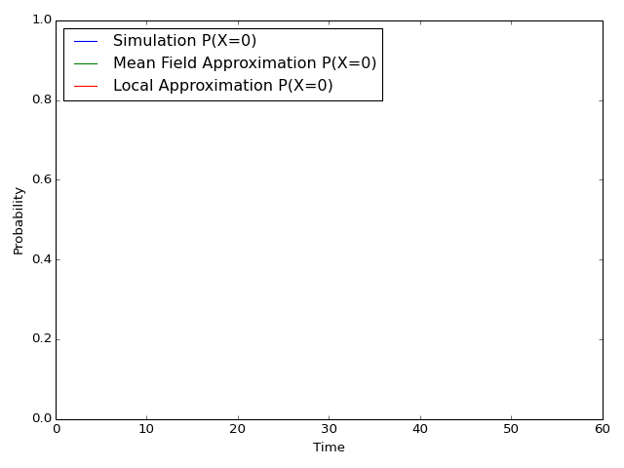
The SIR Process on a Ring (with our local approximation)
Interaction Network
$$n=50$$

Slide 22
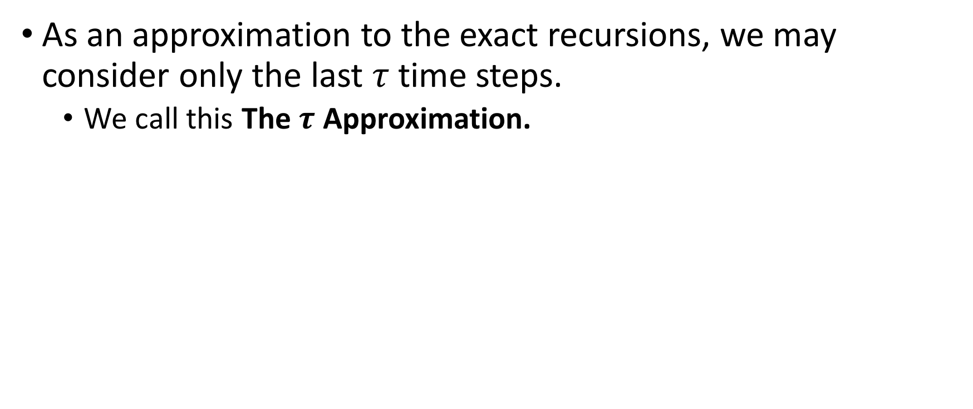
Local Recursions: Time Complexity
As an approximation to the exact recursions, we may consider only the last $τ$ time steps.
We call this The $τ$ Approximation.

Slide 23
Other Existing Approximations
Dynamic Cavity Method
Only exact for trees.
Requires consideration of the dynamics of all particles in the graph (slow).
Not clear how to implement for continuous state space.
No fast approximation.
Moment closure methods (i.e. Pair Approximation):
Makes a huge assumption (that the time marginals satisfy the spatial Markov property).
For many models (e.g. SIR) this approximation is very inaccurate (Gast, 15).

Slide 24
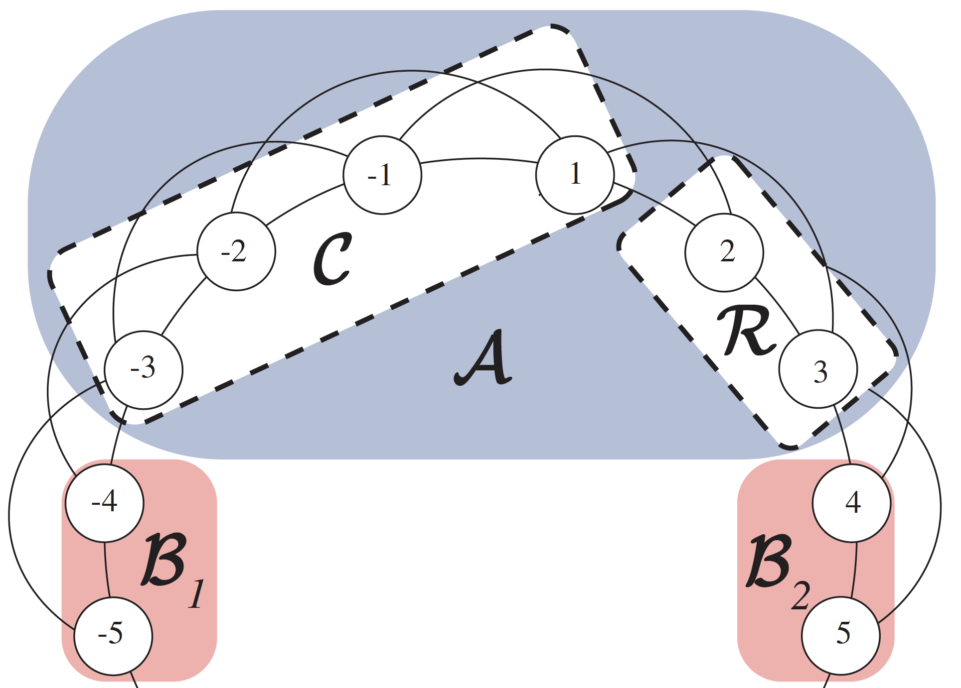
Generalizations to Other Graphs
Our method generalizes to non locally-tree-like graphs.
For example, the graph which arises in Load Balancing on a ring.

Slide 25
Summary
In this presentation we have…
Defined Interacting Particle Systems and given examples.
Discussed existing approximations for understanding the behavior of these systems (Mean Field) and highlighted cases where they are not applicable.
Discussed recent theory which reveals a new conditional independence structure.
Building off this recent theory we have demonstrated the effectiveness of our new Local Recursions.

Slide 26
Questions?

Slide 27
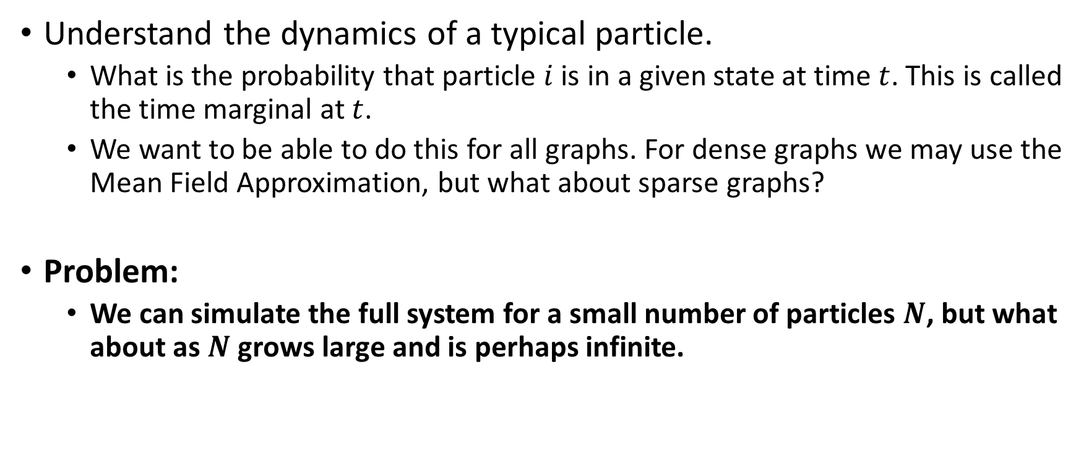
Goals
Understand the dynamics of a typical particle.
What is the probability that particle $i$ is in a given state at time $t$. This is called the time marginal at $t$.
We want to be able to do this for all graphs. For dense graphs we may use the Mean Field Approximation, but what about sparse graphs?
Problem:
We can simulate the full system for a small number of particles $N$, but what about as $N$ grows large and is perhaps infinite.

Slide 28
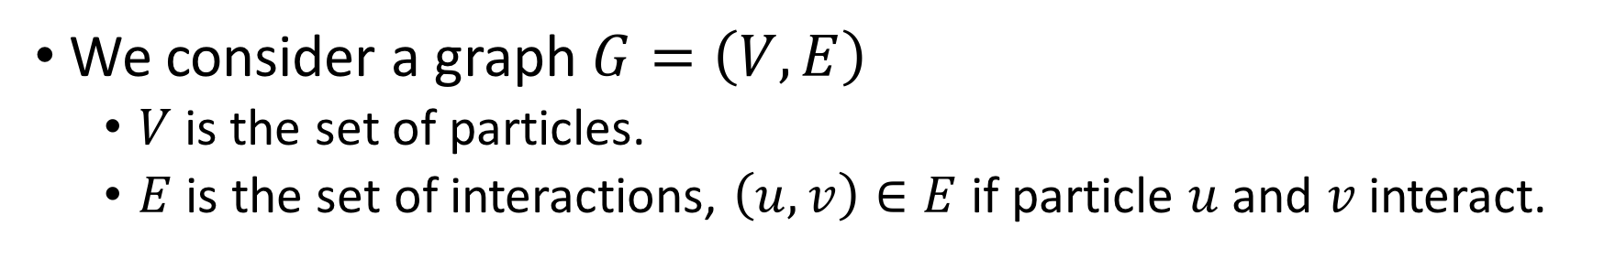
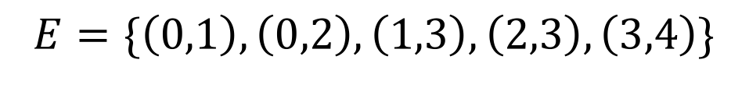
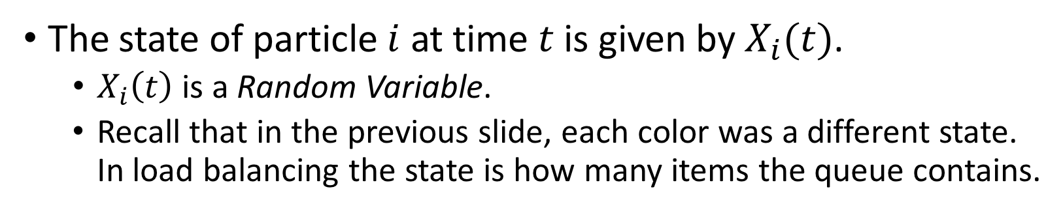
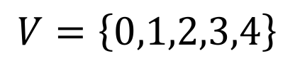
Formal Introduction (1): Interacting Particle Systems
We consider a graph $G=\left(V,E\right)$
$V$is the set of particles.
$E$ is the set of interactions, $\left(u,v\right)∈E$ if particle $u$ and $v$ interact.
Example:
0
1
$$V=\left\{0,1,2,3,4\right\}$$
$$E=\{\left(0,1\right),\left(0,2\right),\left(1,3\right),\left(2,3\right),\left(3,4\right)\}$$
2
3
4
The state of particle $i$ at time $t$ is given by $X_{i}(t)$.
$X_{i}\left(t\right)$ is a Random Variable.
Recall that in the previous slide, each color was a different state. In load balancing the state is how many items the queue contains.
Notes:
- Mention that this is items in queue

Slide 29
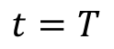
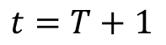
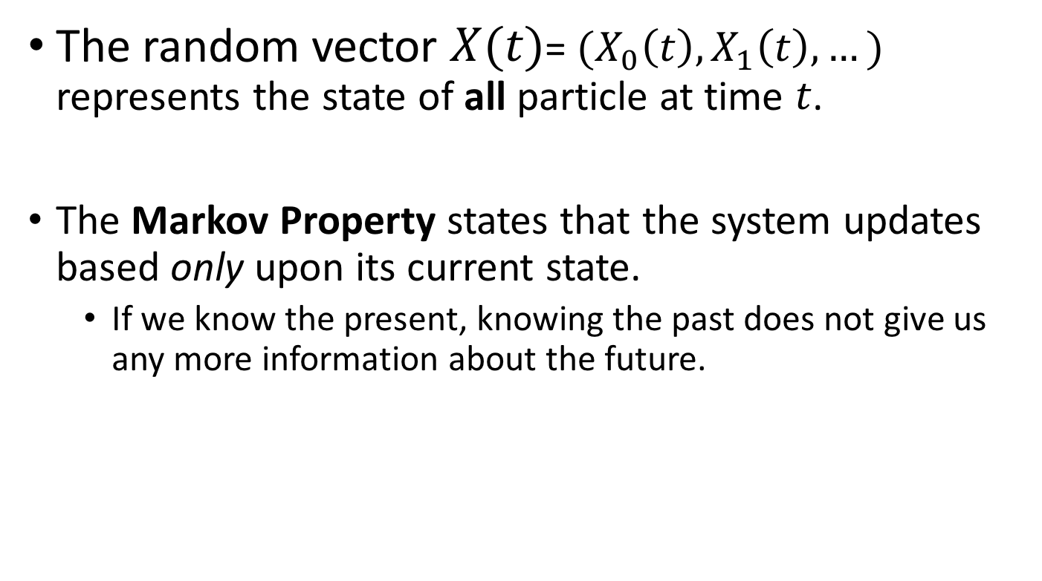
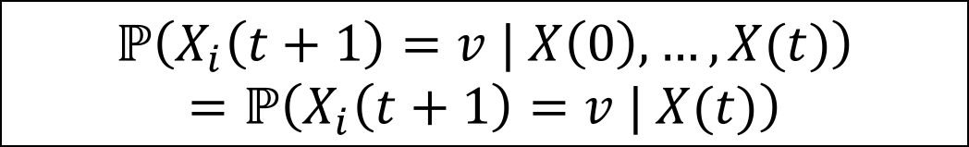
Formal Introduction (2): The Markov Property
The random vector $X(t)$= $(X_{0}\left(t\right), X_{1}\left(t\right),…)$ represents the state of all particle at time $t$.
The Markov Property states that the system updates based only upon its current state.
If we know the present, knowing the past does not give us any more information about the future.
$$t=T$$
$$ℙ\left(X_{i}\left(t+1\right)=v | X\left(0\right),…,X(t)\right)$$
$$=ℙ\left(X_{i}\left(t+1\right)=v | X(t)\right)$$
$$t=T+1$$

Slide 30
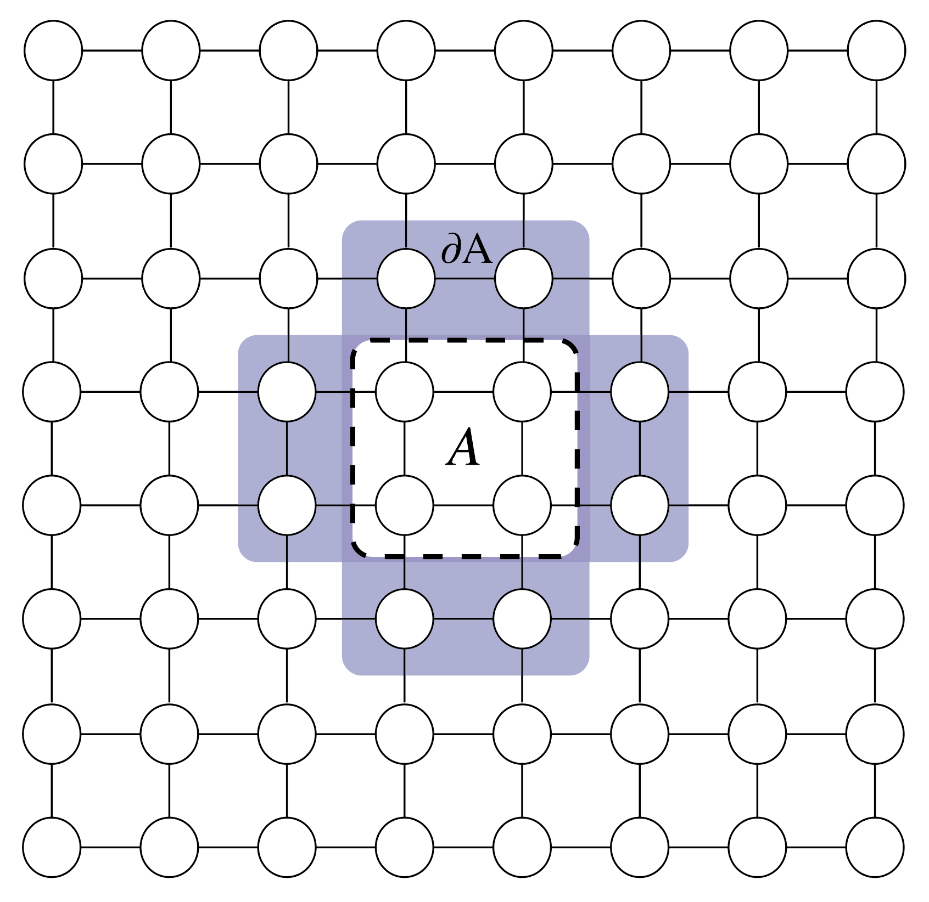
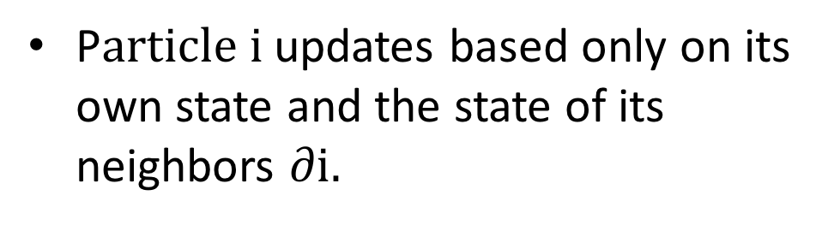

Formal Introduction (3): Local Interactions
P$article i$ updates based only on its own state and the state of its neighbors $∂i.$
$$ℙ\left(X_{i}\left(t+1\right)=v | X(t)\right)$$
$$=f\left(v, { X}_{i}\left(t\right), { X}_{∂i}\left(t\right)\right)$$

Slide 31
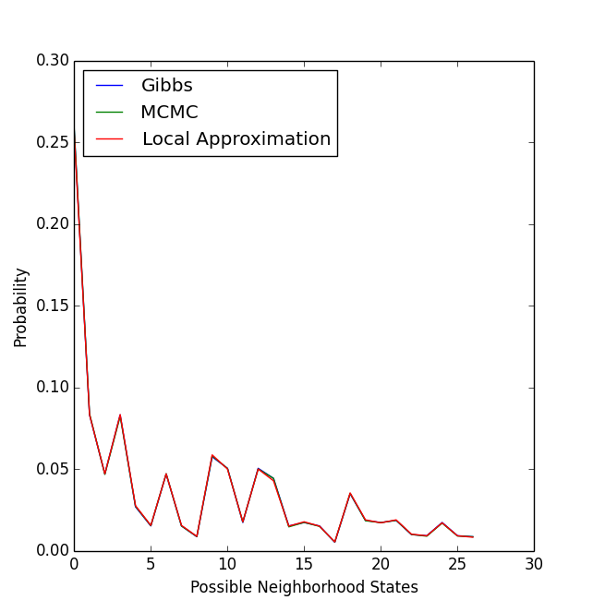
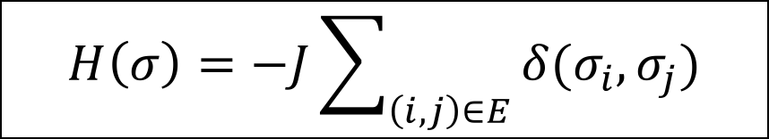

Potts Process
For the Potts process, the stationary distribution is given.
Therefore you may sample from it with MCMC.
In the other models discussed, this stationary distribution is not given.
Here we show the time marginal at a large T (T=100) to confirm that our model matches the given stationary distribution close to equilibrium.
$$H\left(σ\right)=−J\sum_{\left(i,j\right)∈E}{δ(σ_{i},σ_{j})}$$
$$P\left(σ\right)=\frac{e^{−βH\left(σ\right)}}{Z_{β}}$$
T=100, 3 States, 100,000 samples from MCMC
Notes:
Close to equilibrium
When spatial markov property is satisfied, we can use MCMC to sample from the distribution.
While that is true for the Potts it is not true for load balancing and SIR (put this earlier)

